Slide 1
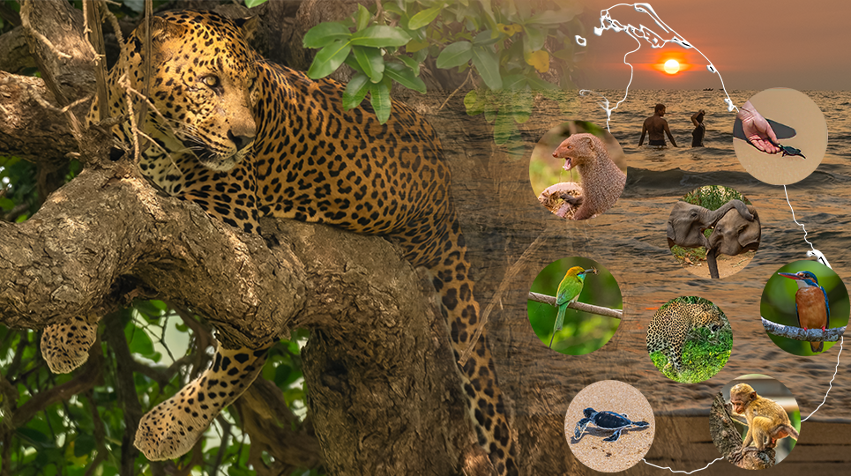
Welcome
Analysing photography holidays in Sri Lanka
Roshan Ranadeerage]
Data Analytics

Slide 2


The Question
Is there significant demand for photography holidays in Sri Lanka?
To assess the demand for photography holidays in Sri Lanka, it is essential to examine the activities that holidaymakers engage in, the destinations they favour during their travels and identify frequent photography holidaymakers.
https://www.wanderlustmagazine.com/inspiration/wanderlust-travel-awards-2024-the-results

Slide 3

Hypothesis
There is a significant demand for photography holidays in Sri Lanka. Travellers who choose these holidays tend to engage in specific related activities, visit locations that are popular for photography, and a substantial portion of these travellers are repeat visitors.

Slide 4
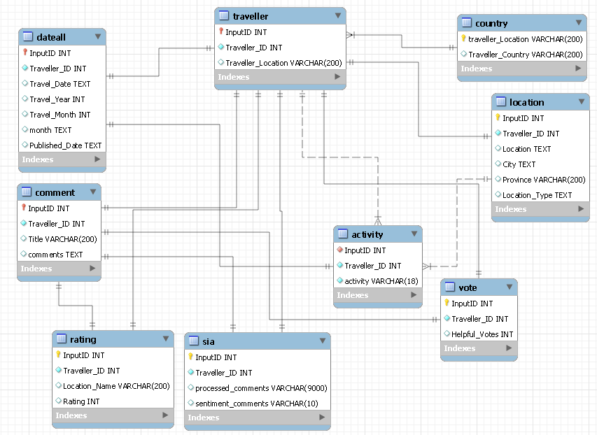






Data and Tools Used
Repurposing publicly available dataset related to tourism and travel reviews in Sri Lanka from 2010 to 2023, the Ecocapture database was created from the source dataset. New tables such as country, activity and SIA (sentiment analysis) were created based on the source tables. (See appendix for more details)
Ecocapture Database
ETL.py
Reviews.CSV
Country Mapper
Sentiment analysis.py
Qc Data extraction.py

Slide 5
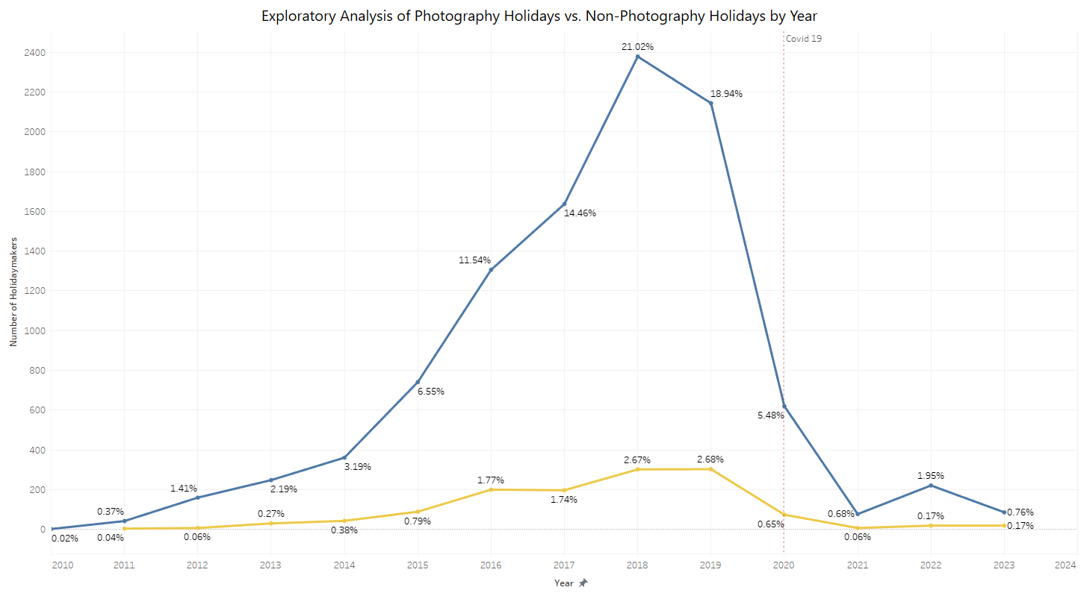
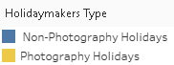
Statistical Analysis
The pandemic had a notable impact on travel plans, causing a decline in both photography and non-photography holidays.
The severity of the impact was more pronounced in photography holidays, possibly due to travel restrictions and concerns over health and safety.

Slide 6
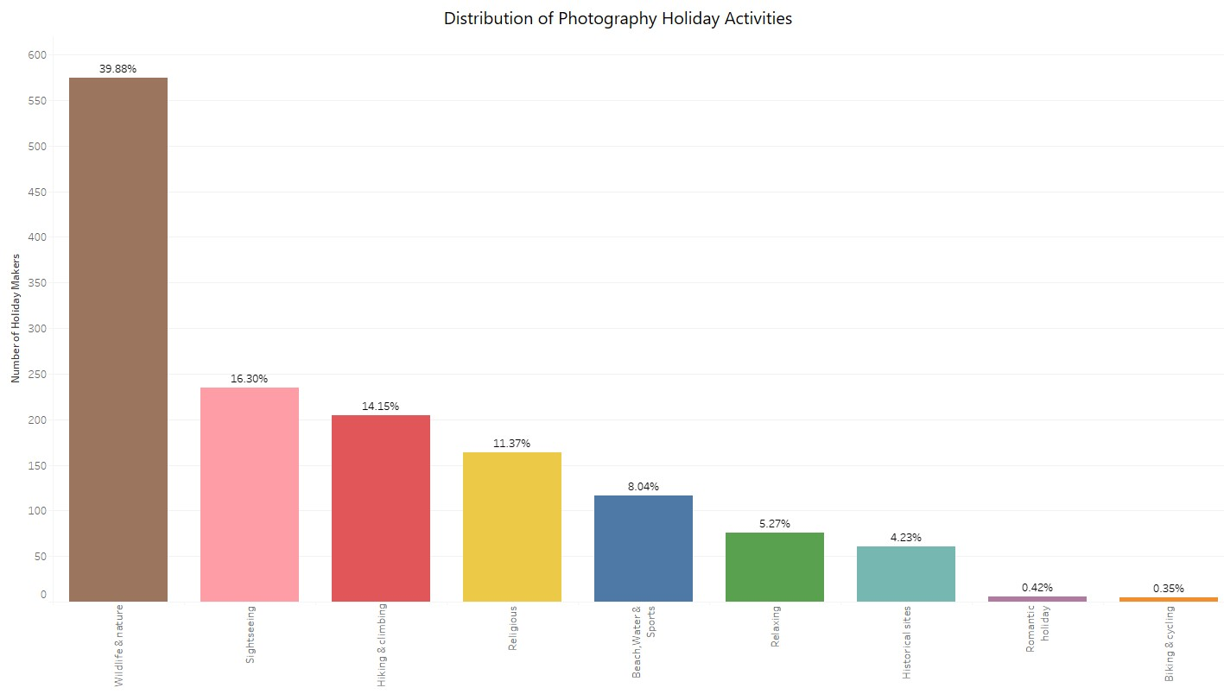
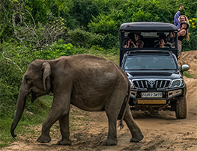
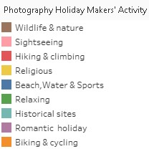
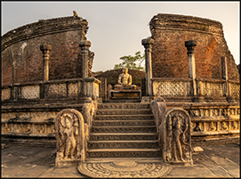
Statistical Analysis (Continued)
Wildlife & Nature tops the chart, indicating that nearly 40% of photography holidaymakers prefer to immerse themselves in the natural world.
Historical sites attract 4.23% of photography holidaymakers, reflecting an interest in capturing the architectural and cultural heritage of different destinations.

Slide 7
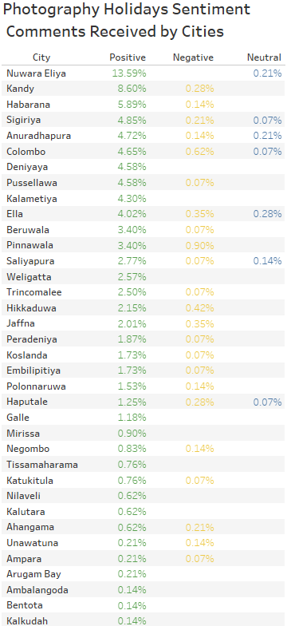
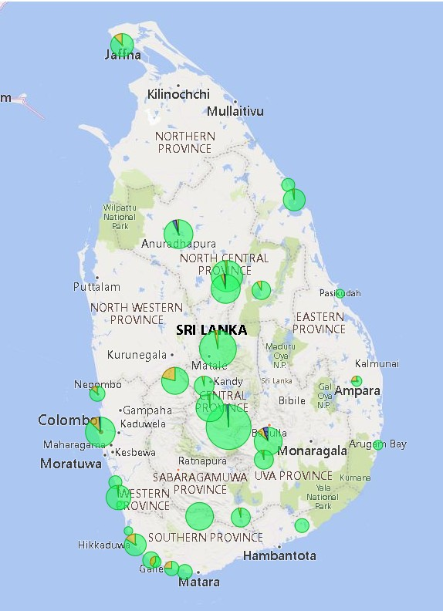
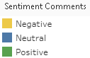
Statistical Analysis (Continued)
Nuwara Eliya stands out as the most positively perceived city in terms of photography holidays, with 13.59 % of total sentiment comments being positive.
Following Nuwara Eliya, Kandy has 8.60% positive comments, placing it in a prominent second place.
Cities with lower percentages of positive comments, such as Bentota and Kalkudah, each at 0.14%, show limited but present positive feedback, suggesting potential areas for growth in photo tourism.

Slide 8
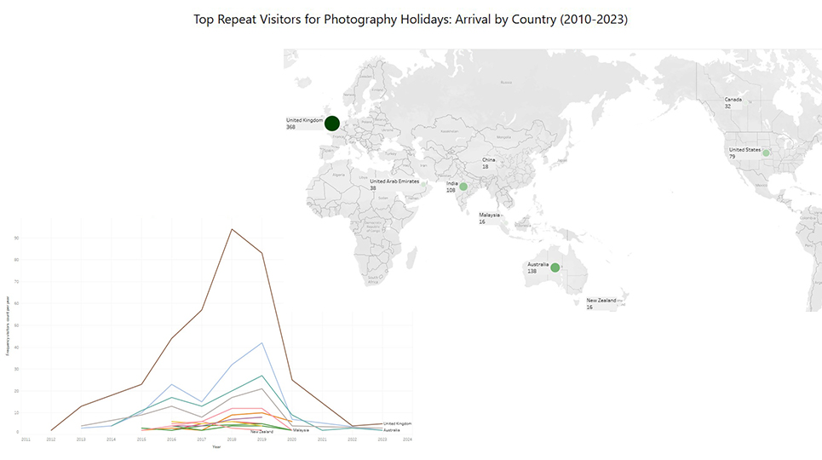
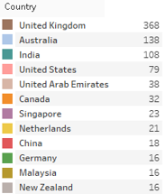
Statistical Analysis (Continued)
This data highlights the importance of targeting these countries for marketing photography holiday packages. Understanding the preferences and travel patterns of these repeat visitors can help tourism operators tailor their offerings to better meet the needs and interests of these travellers.

Slide 9
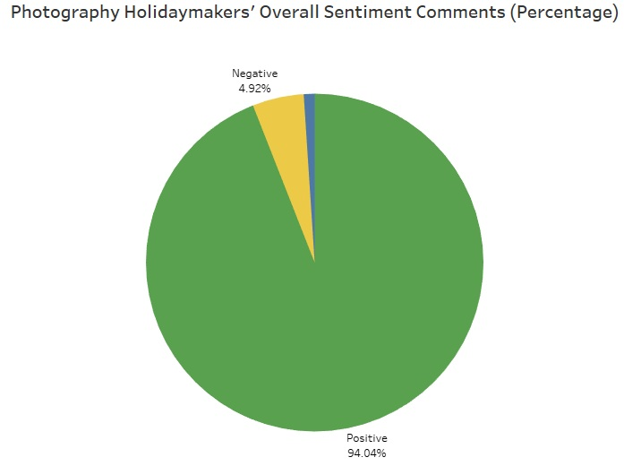
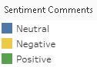
Statistical Analysis (Continued)
Example of neutral sentiment: A quick stop at this place on the way to south beaches from Ella. Right in the road. Big cascading waterfall, but pretty average one with nothing special or extraordinary. Good for a stopover and photo opportunity.
Example of positive sentiment:
Brief Gardens is a masterpiece of landscaping.
I could have spent all day here, observing the play of light and shadow in the changing daylight. It is also a wonderful opportunity for photography. A single visit will hardly do it justice. This was my second visit, and I shall certainly return in another season.
Example of negative sentiment: I've visited Sri Lanka three times over the recent years and always make a visit to jungle beach. This time I was shocked and saddened to see how much rubbish and plastic were left on the beach. …

Slide 10
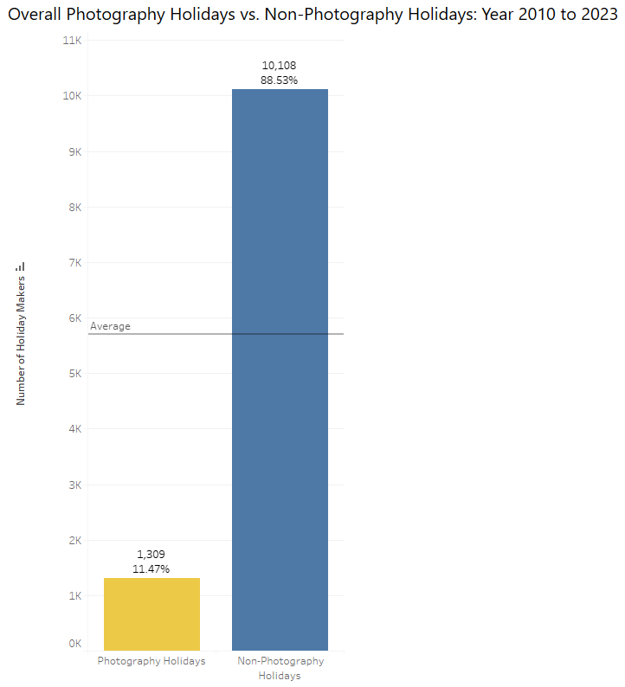
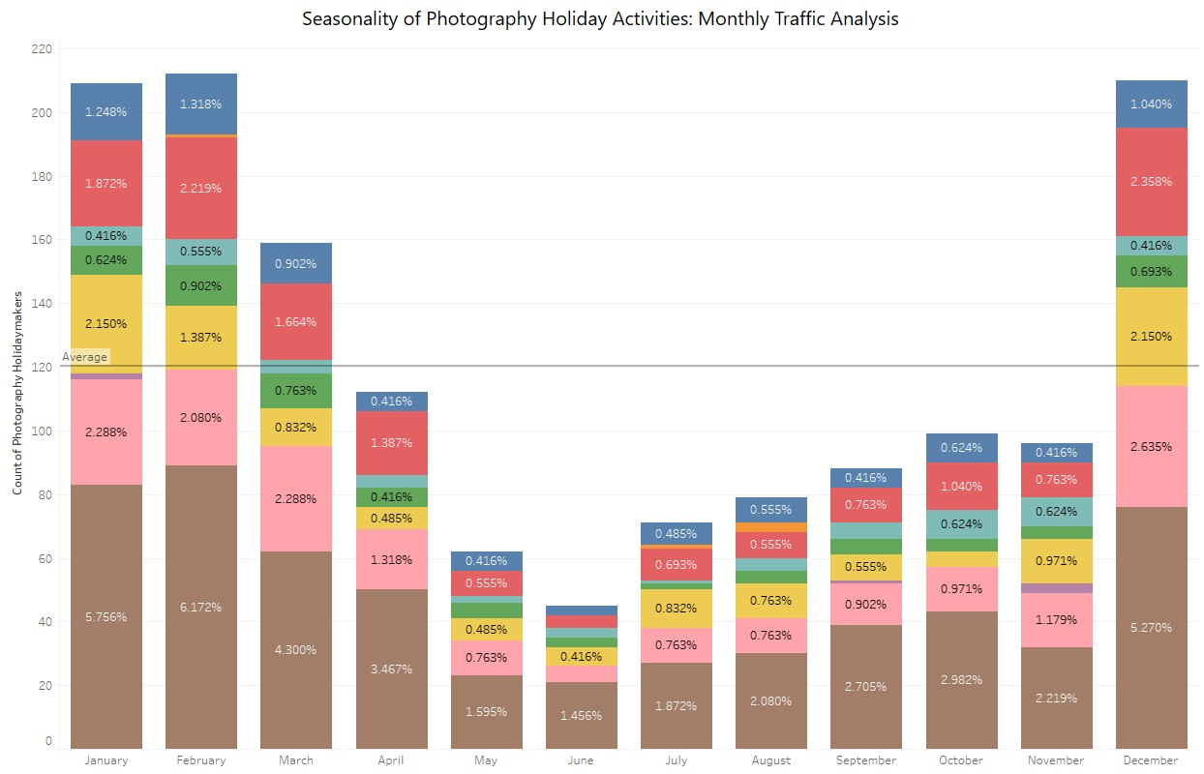
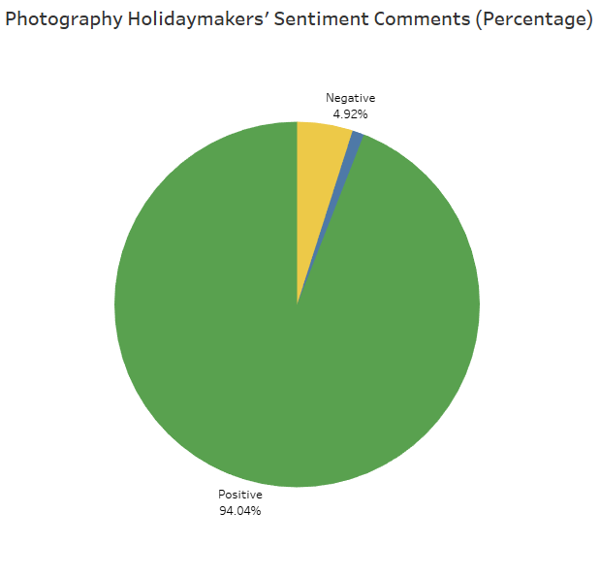
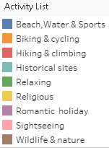
Insights
European winter months
94% of the comments were positive, This indicates a high level of satisfaction among photography holidaymakers, suggesting that they have enjoyable and fulfilling experiences during their photography holidays. Such positive feedback is invaluable for tour operators and travel agencies, as it highlights the effectiveness of their services and the overall satisfaction of their customers.
11.47% of the holidaymakers indicates a niche yet dedicated group of travellers who specifically seek out photography-focused trips.
The highest traffic for photography holiday activities occurs in the European winter months of January, February, March and December, with a noticeable dip during the summer months, particularly in June.
This seasonality trend is relevant for understanding the peak times for photography holiday activities and can be useful for planning and marketing strategies in the photography tourism industry.

Slide 11
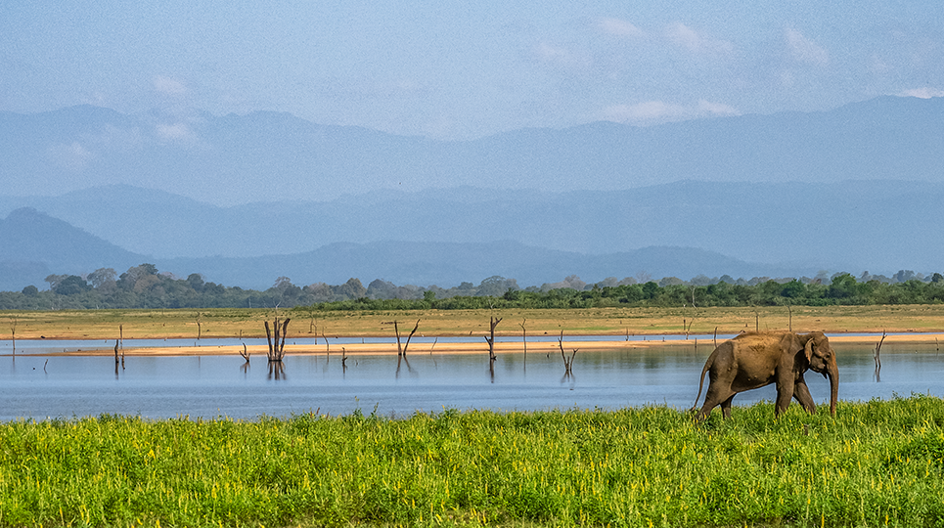
Summary Conclusions
Overall, the data supports the hypothesis that there is a significant demand for photography holidays in Sri Lanka, with holidaymakers engaging in specific photo related activities, visiting popular locations, and a substantial portion being repeat visitors.
This insight can help tourism operators better tailor their offerings to meet the needs and interests of photography enthusiasts.

Slide 12
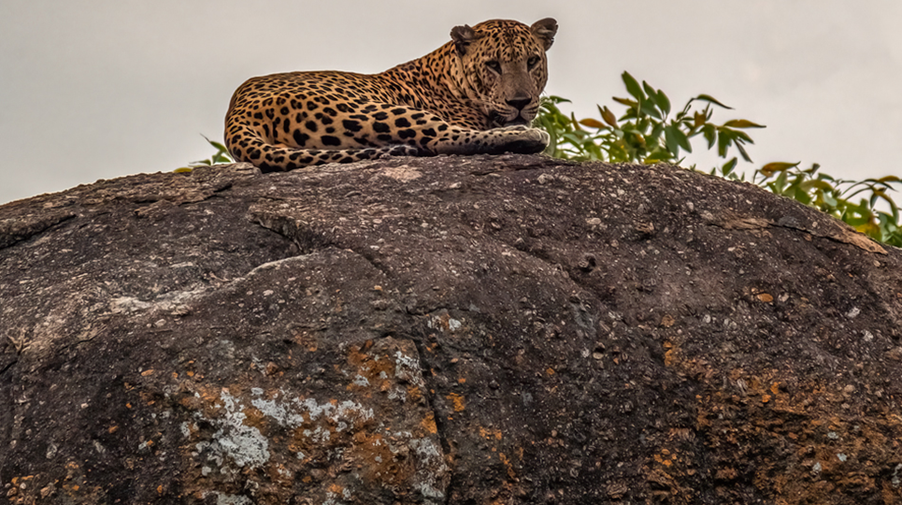
Key Learnings
From the next version, categories such as ‘Relaxing’ and ‘Biking and cycling’ will be removed from photography holiday activities.

Slide 13

Appendix

Slide 14
Source Data
Appendix
Publicly available dataset and selecting photography holidays from comments.
Located_City | Location | Location_Type | User_ID | User_Location | User_Locale | User_Contributions | Travel_Date | Published_Date | Rating | Helpful_Votes | Title | Text
Hikkaduwa | Hikkaduwa, Galle District, Southern Province | Beaches | User 511 | Wangaratta | en_US | 658 | 2018-10 | 2018-10-05T21:16:36-04:00 | 5 | 1 | Beautiful beach | A lovely stretch of beach with some evidence of tsunami still present. Great photography opportunties
Nuwara Eliya | Nuwara Eliya, Central Province | Bodies of Water | User 2176 | Mumbai, India | en_IN | 53 | 2018-12 | 2019-01-02T22:39:13-05:00 | 5 | 0 | Beautiful, scenic lake | Beautiful, scenic lake with great water sports activities that makes for a great place to spend a few hours and click great photographs!
Kandy | Kandy, Kandy District, Central Province | Bodies of Water | User 2376 | Selby, United Kingdom | en_UK | 72 | 2019-02 | 2019-04-05T00:49:36-04:00 | 3 | 0 | Ok | The lake is pretty but not spectacular. We walked around some of it but to be honest I didn't find many views that warranted taking a photo - and I'm always snap happy! However if you're visiting Kandy it's quite pleasant for a stroll.
Kandy | Kandy, Kandy District, Central Province | Bodies of Water | User 237 | Dibba Al Bay Ah, Oman | en_US | 162 | 2019-04 | 2019-04-04T06:54:02-04:00 | 5 | 0 | To know more about kandy | Beautiful lake, as I heard from the local people it��s holy as it��s connected to the Temple of the Sacred Tooth Relic. Cozy place, a lot of people walking around. Close to the local market. One of the place to have pictures.
Nuwara Eliya | Nuwara Eliya, Central Province | Farms | User 2752 | Doha, Qatar | en_US | 52 | 2018-12 | 2018-12-05T07:30:12-05:00 | 4 | 0 | Very informative and good views | The guide for The tea factory Mr. Abdullah was very good and proficient. He covered all the details related to tea processing Later we took some snaps of spectacular views from tea estate On return they provide a complementary black tea and restaurant is good with few simple eateries Overall a not to be missed experience
Link to the source dataset https://data.mendeley.com/datasets/2nbvx5m4hs/1

Slide 15
Country table
Appendix
Country table
Identifying and addressing missing or unclear country names by linking them to the data points associated with city name entries.
Country mapping spec.

Slide 16
Photography and non-photography
Appendix
Distinguishing between photography visits and non-photography visits by setting a variable, such as “Photography.”

Slide 17
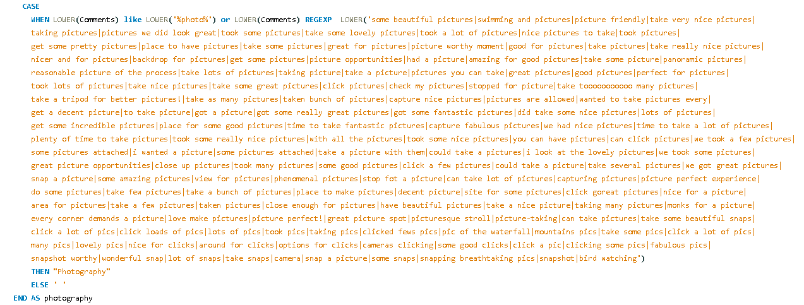
Photography and non-photography
Appendix

Slide 18
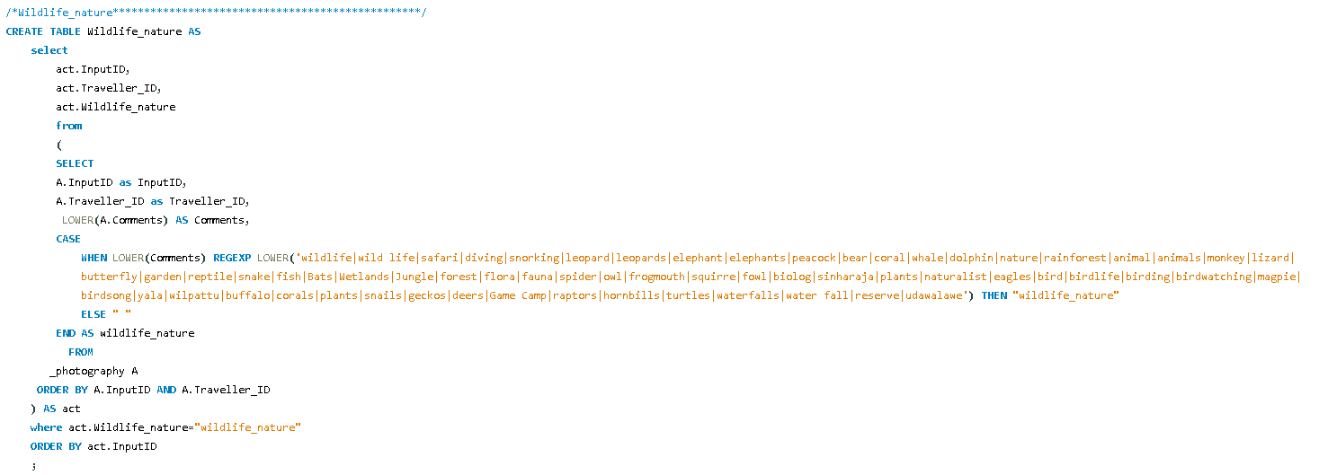
Activity table
Appendix
Activity table

Slide 19
Photo Visit Rating Dataset
Appendix
Example of the “Photo Visit Rating Dataset” after excluding non-photography visitors.

Slide 20
Thank You
References
Link to the source dataset https://data.mendeley.com/datasets/2nbvx5m4hs/1
Sri Lanka Tourism Development Authority (SLTDA) https://www.sltda.gov.lk/en/statistics
Sentiment Analysis: First Steps With Python's NLTK Library https://codefather.tech/blog/nltk-python-sentiment-analysis/

